Slide 1
Object Oriented Programming
(Methods in detail, Inheritance, Polymorphism)

Slide 2
Methods - review
A methods are blocks of code which only run when they are called
Collection of logically related instructions
Methods are used to perform certain actions
Methods are referenced by name – message identifier
Data can be passed to methods – known as parameters
Can have return value
Not independent components, parts of objects

Slide 3
Method declaration
<visiblity> <return type> <method name>([formal parameters])
{
<method body>
}
public int square(int value) {
return value*value;
}

Slide 4
Method parameters
Parameters declared in the formal parameter list can be referred by their name in the message body.
Formal parameters:
Given in compile type
Actual parameters:
Given in run time
Formal parameter
public static int square(int value) {
return value*value;
}
public static void main(String[] args) {
int length = 5;
int area = square(length);
}
Actual parameter

Slide 5
Method parameters
Formal parameters and actual parameters are matched in run time
All parameters are passed by value
Also reference type variables
Value of reference is the address of referenced region, therefore caller and method work on the same allocated area.

Slide 6
Method signature
Combination of
Method name
Method parameter type list
Not part
Visibility modifier
Return type
Parameter name
public int calcAnswer(int op1, int op2)
{
return op1 + op2;
}

Slide 7
Method identification
Developer calls methods by sending message to the class/object (name), but JVM identifies by signature.
In different context
Methods can exist with same name – obvious
In the same context
Methods also can exist with same name
Methods can NOT exist with the same signature – clear identification

Slide 8
Method overload
An object can execute different behaviors for the same message name, because methods to execute are identified by message name and parameter types.
Defining methods in a class with same name, but different signature is called method overload.
Helps developers to identify logically equal behaviors which differ by parameter types.

Slide 9
Method overload
public int calcAnswer(int op1, int op2)
{
return op1 + op2;
}
public float calcAnswer(float op1, float op2)
{
return op1 + op2;
}

Slide 10
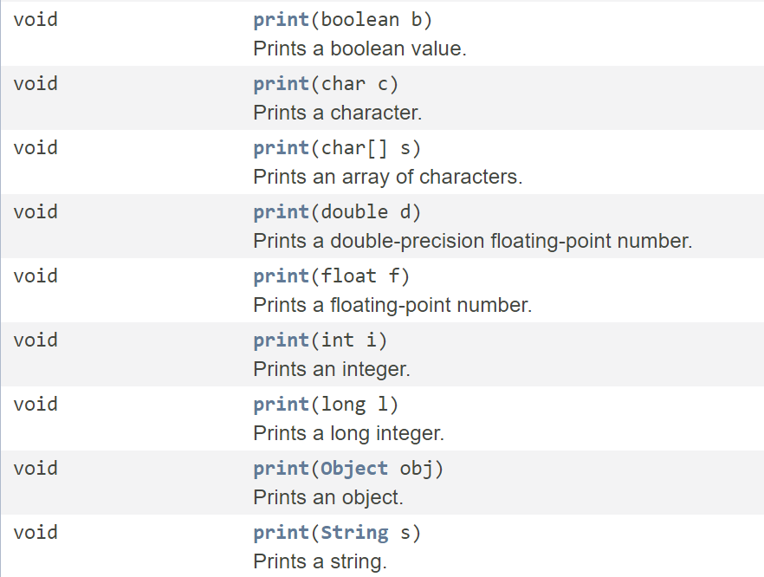
Method overload
print method of
PrintStream class

Slide 11
Constructor overload
public Document()
{
title = ””;
author = ””;
}
Constructor is a method for initialization
Such a method also can be overloaded
The class could have more constructors
public Document(String title, String author)
{
this.title = title;
this.author = author;
}

Slide 12
Object oriented programming
Inheritance and polymorphism

Slide 13
Reuse I – Classes and objects
Creating more of similar things:
Declare the class
Create instances of class - objects
All objects of the same type have:
Same state descriptors
Same behaviors – Shared methods, working on instance data
Custom values – instance data, instance state

Slide 14
Reuse II – Inheritance
Special class declaration – result of object oriented design
Based on an existing source class (ancestor/parent)
New class (descendant/child) contains all components of the source class
data members
properties
behaviors
New class can contain new components
New class extends its ancestor

Slide 15
Open/Close principal
SOLID
Software entities (classes) should be open for extension, but closed for modification

Slide 16
Theoretical application
Inheritance is a tool of specialization of an abstract class, to
based on a template or its ancestor
maintain more specialized states
described by more data members
contain more behaviors connected to specialized functionality

Slide 17
Inheritance and visibility
Visibility descriptors are
public – available from any scopes
package private – available in declaring package, not from outside (default)
protected – private + subclasses of declaring class
private – available in scope in which component was declared

Slide 18
Inherited components
Descendant class inherits all public states and behaviors of its ancestor
Descendant class inherits all protected states and behaviors of its ancestor
All private state descriptors and private behaviors also have to be inherited
But from descendant, private components are not available
Descendant inherits the abstract interface of the ancestor

Slide 19
Inheritance in practice
class Document {
public String title;
}
class Book extends Document {
public int pageNumber;
}
class FolkTale extends Book {
public String area;
}
class Novel extends Book {
public String author;
}

Slide 20
Inheritance in practice
Document
title
Book
title
pageNumber
FolkTale
title
pageNumber
area
Novel
title
pageNumber
author

Slide 21
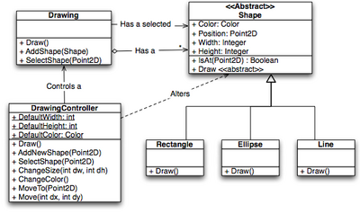
Class hierarchy
Can be described by
Block diagram
UML diagram
…

Slide 22
Single inheritance
Each classes have exactly one ancestor
If no one is specified, Object is rendered by the compiler
The root is the Object class
Many methods are inherited by default

Slide 23
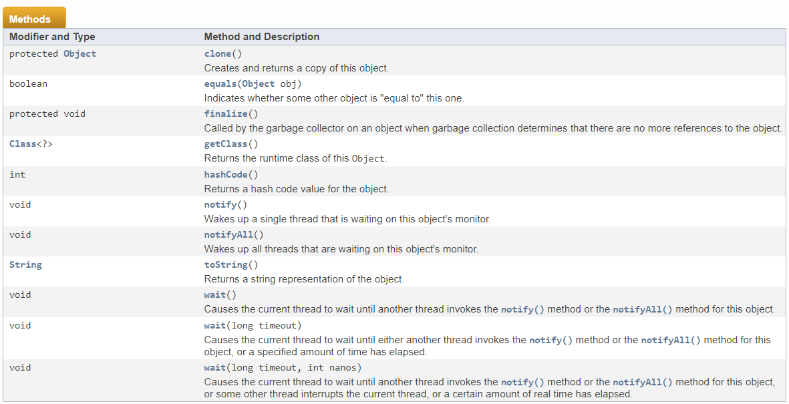
Methods inherited from Object

Slide 24
Inheritance and constructor
Constructors are NOT inherited
On initialization, descendant class first calls constructor of ancestor class.
If other is not set explicitly, by default tries to call default constructor
If there is no default constructor in ancestor, descendant has to contain explicit constructor to specify what to call in ancestor

Slide 25
Calling constructor
public class Child extends Parent {
public Child(int someArg) {
super(someArg);
// custom code
}
// other extension
}

Slide 26
Specialization of behavior
Specialization is when declaring a descendant class based on an existing one, to handle a more special task, with single responsibility
Interface of ancestor is inherited
Ancestor extended
What if an existing behavior has to be specialized/modified?

Slide 27
Polymorphism – method override
When modifying a behavior declared in an (direct or indirect) ancestor class .
In a lower level of abstraction, a more specialized behavior is required, therefore the descendant class declares a custom behavior, but does not modify behavior declaration of the ancestor.
The newly declared method has the same declaration as the old one.

Slide 28
Liskov substitution principal (1988)
SOLID
Subtype Requirement: Let Φ(Χ) be a property provable about objects x of type T. Then Φ(y) should be true for objects y of type S where S is a subtype of T.
If S is a subtype of T, then objects of type T in a program may be replaced with objects of type S without altering any of the desirable properties of that program

Slide 29
Polymorphic declaration
Polymorphic method declaration is to override an inherited component
Visibility modifier can be extended
Return type can not be changed
Same signature
Name
Parameter types
Parameter names can be changed

Slide 30
Method override
public class Parent {
public String getClassName()
{
return "Parent";
}
}
public class Child extends Parent {
public String getClassName()
{
return "Child";
}
}

Slide 31
Override in practice
public class Mammal {
public String say() { return „Noise"; }
}
public class Cat extends Mammal {
public String say() { return „Meow"; }
}
public class Dog extends Mammal {
public String say() { return „Bark"; }
}
public class Fox extends Mammal {
public String say() { return „Ring-ding-ding-ding-dingeringeding"; }
}

Slide 32
Call overridden methods
Parent parent = new Parent();
Child child = new Child();
System.out.println(parent.getClassName()); // out: Parent
System.out.println(child.getClassName()); // out: Child

Slide 33
Resolve method reference
When calling a method, reference has to be resolved
Compiler resolves the method reference by
walking up on the class hierarchy
using the method closest to the caller context

Slide 34
Polymorphism – method override
All methods of a class could be overridden by default
To disable method override, use final keyword

Slide 35
Plymorphism – operator override
Java does not support operator override
(Other languages, like C# do support)
Operators for classes can not be defined
Exception is concatenation operator (+) on String class

Slide 36
Type casts
Implicit type cast
Compatible type to bigger storage space
Compatible type to smaller storage space is NOT ALLOWED
Objects can be casted to classes which are higher in the hierarchy
Parent parent = new Child();
Child child = new Parent(); //Incompatible types

Slide 37

Implicit cast
Type cast is enabled to higher class in class hierarchy → to parent classes
Communicate with the object on an interface of its parent
Not converting the allocated area
For cases when inspection or collection is required on higher abstraction level
(Driving rules: vehicle – car, truck, bus, motorbike)

Slide 38
Implicit cast example
Vehicle[] vehicles = new Vehicle[4];
vehicles[0] = new Car();
vehicles[1] = new Truck();
vehicles[2] = new Bus();
vehicles[3] = new Motorbike();
foreach(Vehicle vehicle : vehicles) {
vehicle.accelerate();
}

Slide 39
Explicit type casts
Objects can be casted to any class
Type matching done runtime
Child child1 = new Parent(); //Incompatible types
Child child2 = (Child)(new Parent()); //ClassCastException
Parent parent = (Parent)new Child();
Child child3 = (Child)(parent);
//Valid

Slide 40
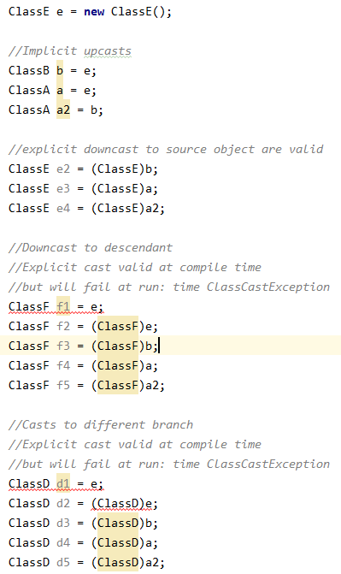
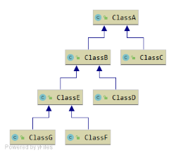
Type casts of ClassE
ClassA
ClassB
ClassC
ClassD
ClassE
ClassF
ClassG

Slide 41
Override inherited interface member
public class Parent {
public String getClassName()
{
return "Parent";
}
}
public class Child extends Parent {
public String getClassName()
{
return "Child";
}
}

Slide 42
Override inherited interface member
Parent parent = new Parent();
Child child = new Child();
Parent parent2 = child;
Child child2 = (Child)parent2;
System.out.println(parent.getClassName()); // out: Parent
System.out.println(child.getClassName()); // out: Child
System.out.println(parent2.getClassName()); // out: Child
System.out.println(child2.getClassName()); // out: Child

Slide 43
Static override
Static method can not be overridden
Redeclaration of static method in an inherited class is allowed
Will create a new behavior for the successor
Will not override behavior of ancestor, just hide it
Used method depends on interfaces used for communication

Slide 44
Hide static method
public class Parent {
public static String getStaticName() {
return "Parent";
}
}
public class Child extends Parent {
public static String getStaticName() {
return "Child";
}
}

Slide 45
Hide static method
Child child = new Child();
// create object
Parent parent = child;
// cast up
Child c2 = (Child)parent;
// cast back down
System.out.println(Parent.getStaticName()); // Parent
System.out.println(Child.getStaticName()); // Child
System.out.println(child.getStaticName()); // Child
System.out.println(parent.getStaticName()); // Parent
System.out.println(child2.getStaticName()); // Child

Slide 46
Disable inheritance – final
To exclude class from inheritance, use final keyword
Such a class can not be extended/subclassed
To disable method to be overridden, use final keyword
Such a method can not be redeclared in a descendant class

